Slide 1
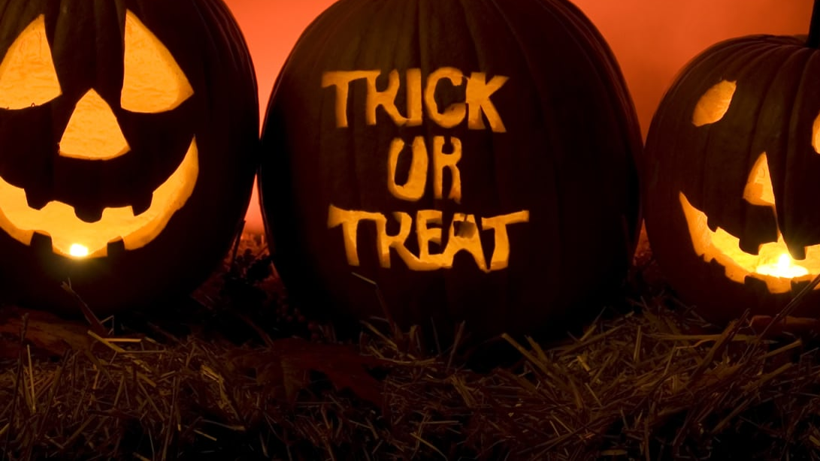
Halloween Assignment
Submitted by- Simron Dora
Student ID- 100791429
Instructor- Professor Thomas Francescutti

Slide 2
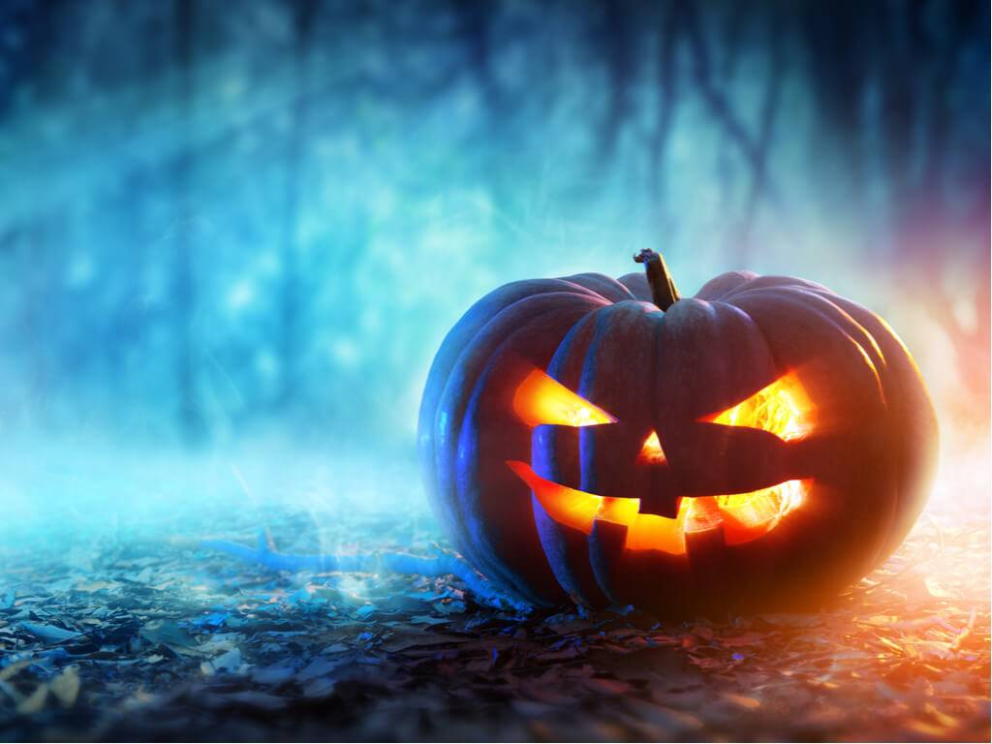
It's observed that the total number of visitors have increased each year. 2011 seen the maximum number of visitors.
Year/Time | 2008 | 2009 | 2010 | 2011 | 2012 | 2013 | 2014 | 2015 | 2016 | 2017 | 2018 | Grand Total
6pm | 0 | 0 | 0 | 0 | 0 | 33 | 0 | 13 | 22 | 41 | 18 | 127
6:30pm | 75 | 52 | 172 | 172 | 147 | 119 | 106 | 135 | 138 | 149 | 173 | 1438
7pm | 117 | 177 | 179 | 195 | 163 | 81 | 91 | 188 | 226 | 167 | 151 | 1735
7:30pm | 147 | 150 | 187 | 252 | 232 | 70 | 124 | 187 | 226 | 192 | 155 | 1922
8pm | 144 | 143 | 185 | 197 | 111 | 68 | 115 | 144 | 147 | 161 | 92 | 1507
Total(8:15pm) | 9 | 20 | 3 | 53 | 20 | 20 | 18 | 80 | 63 | 66 | 11 | 363
Its observed that most of the visitors arrive between 7PM-8PM

Slide 3

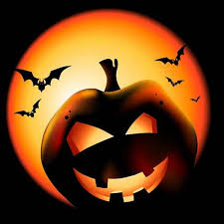
Historical Halloween Spending(in Billions)
The Total Halloween spending has grown 12% every year. Halloween spending expected to reach $8.4B

Slide 4
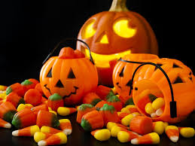
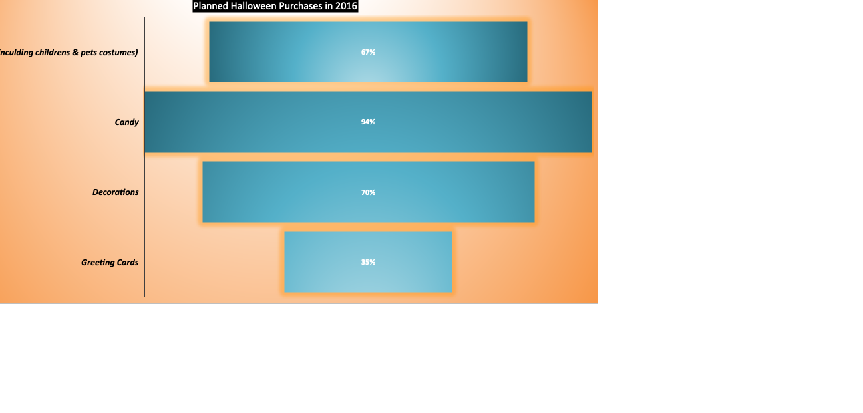
As per the survey most shoppers spend their budget on Candies & Costumes. In 2016, Halloween Shoppers plan to spend 94% on Candies while 67% in Costumes

